Slide 1
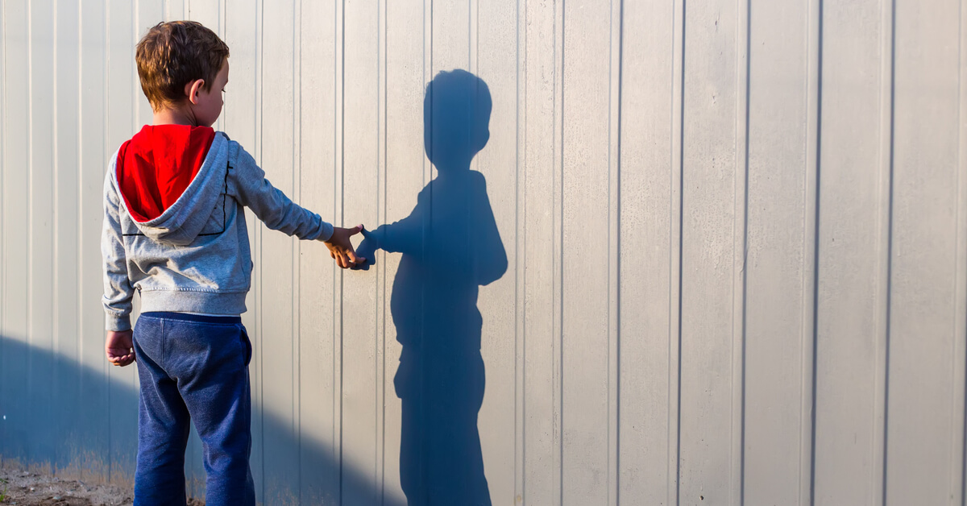
Project Name: Overcome Autism.
Team Member:
1) Mohamed Abdelmoniem Mohamed.

Slide 2
Agenda
The Problem Definition.
The Proposed Solution.
The People who are targeted by the application (The Target of App ).
First Section (Powerful person)
Second Section (Family)
Third Section (General People)
Donations Section.

Slide 3
The Problem Definition
Autistic Person: a person has problems with social communication.
Therefore, society will not be able to benefit from the capabilities of the autistic person, Also, autism is also a disease that sometimes requires a therapist.

Slide 4
The Proposed Solution
Help autistic people overcome autism in modern and fun practical ways and according to medical supervision.
So, we create App to target autistic person, their family and general People.

Slide 5
The Target of Application
The App is target 3 types of people with 3 Department :
1) The autistic person.
2) The Family of the autistic person.
3) People in General.

Slide 6
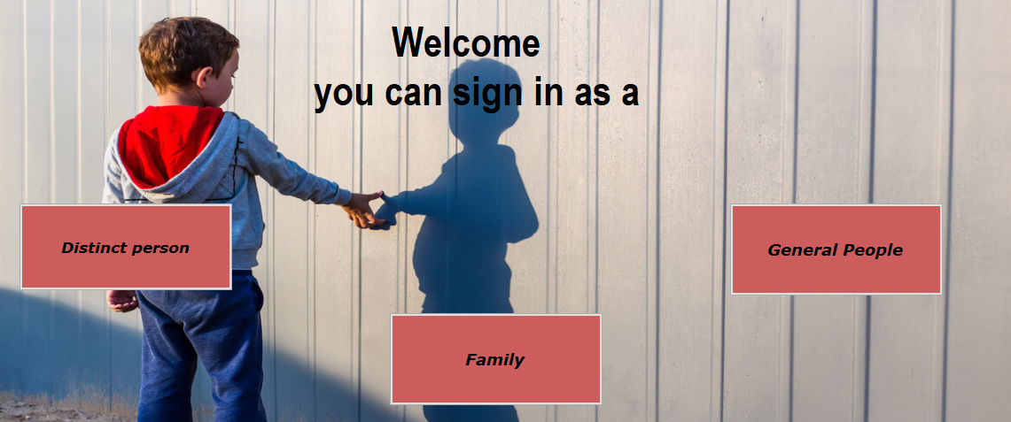

Slide 7
The Distinct person Section
In this Department there are many sections:
1) Road Map for overcoming autism.
2). Achievements board
3) Articles, how to deal with bullying and people in general.
4) WebCam Chat.
5) Playing and Learning.

Slide 8
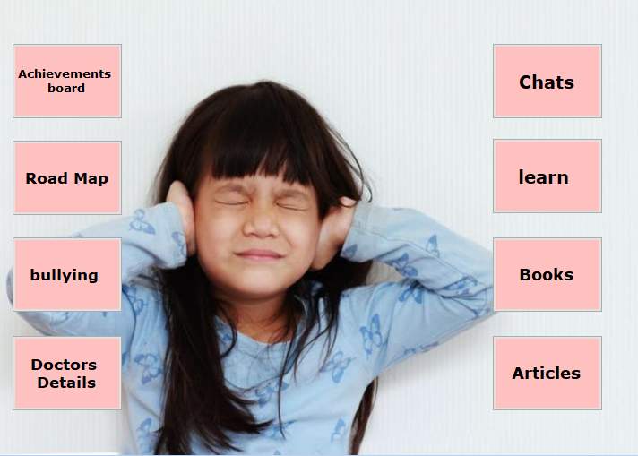

Slide 9
Achievements board Section
1). Momentary && Weekly achievement, to encourage children to continue.
2). Achievements of people who have overcome autism.

Slide 10
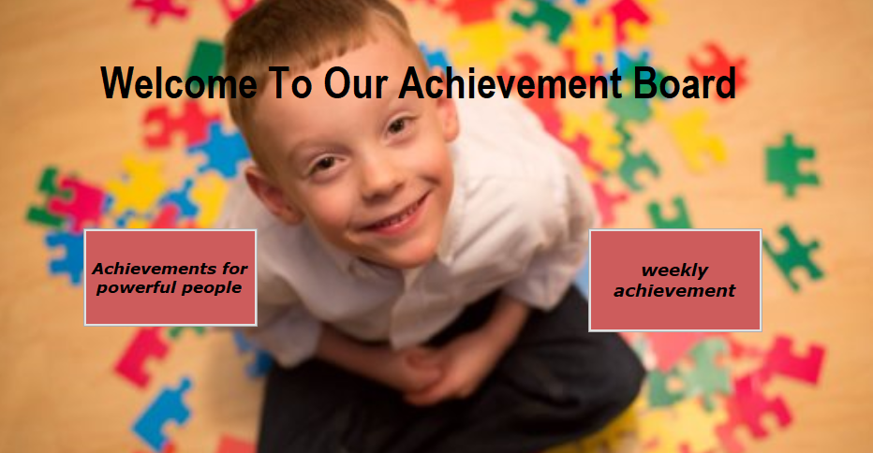

Slide 11
Road Map Section
1) Online courses and exam for each lesson.
If he cannot pass the exam, the new lesson will not be opened.
2) How to use other sections parallel with the road map and level of progress.
So that he doesn't enter a section higher than his level and get frustrated.

Slide 12
Articles Section
1) Motivational articles to encourage them to continue.
2) Articles to tell them that they are distinct and strong people.
3) Articles about the importance of dealing with other people, to encourage them not to give up.

Slide 13
Chat Sections
1) Chat with doctors for free.
2) Group Chat.
3) then we enter it to communicate gradually by way of:
A) At first with autism.
B) then Communicate with others:
a) First in the chat.
b) Then a webcam.
c) Then face to face.

Slide 14
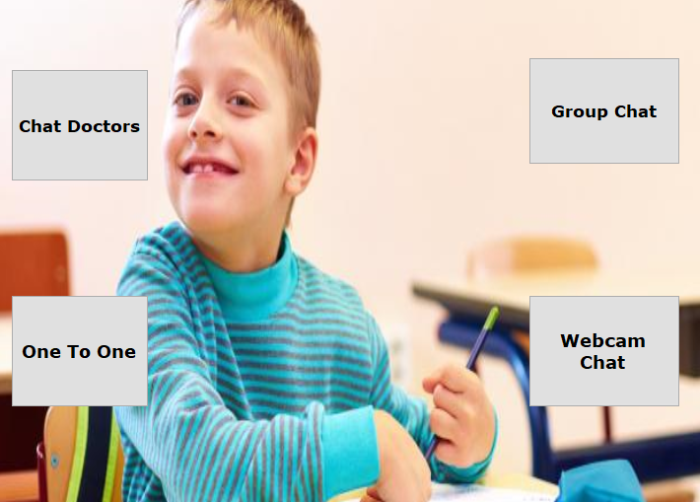

Slide 15
learn Section
During the treatment period, the child will learn some things to benefit him, to have fun, and not give up.
1) technology.
2) maths.
3) sports.
4) art.
5) poem.

Slide 16
Dealing with people Section
Advise on how to deal with people in General.
How to deal with bullying and to make it don't affect his psyche.

Slide 17
The Family Department
we will teach them how to deal with their autistic children in the right way, to overcome autism and encourage them.
We will give them access to their children's roadmap.

Slide 18
General people Department
1) how to deal with autistic people in the right way.
2) Also,
With the spread of technology and smart mobile phones, everyone is vulnerable to autism, so we teach people
how to protect themselves and their children from some of Symptoms of autism.

Slide 19
Donations
anyone can donate any money without registration to help people with autism book an online session with a doctor.

Slide 20
Thank you!

